Slide 1
Audio Vision
By Andres Aguilera

Slide 2
What is Audio Vision?

Slide 3
Who is it for?

Slide 4
Who is it for?
People with visual impairments
Glaucoma
cataracts
Total Blindness

Slide 5
How Does it Work?
This Photo by Unknown Author is licensed under CC BY-NC

Slide 6
YOLOv8
Used to detect the images
Creates list all the detected objects

Slide 7
Pyttsx3
Reads list out loud

Slide 8
TensorFlowLite
Deep learning framework
Used to deploy machine learning models onto mobile architectures
Not yet implemented

Slide 9
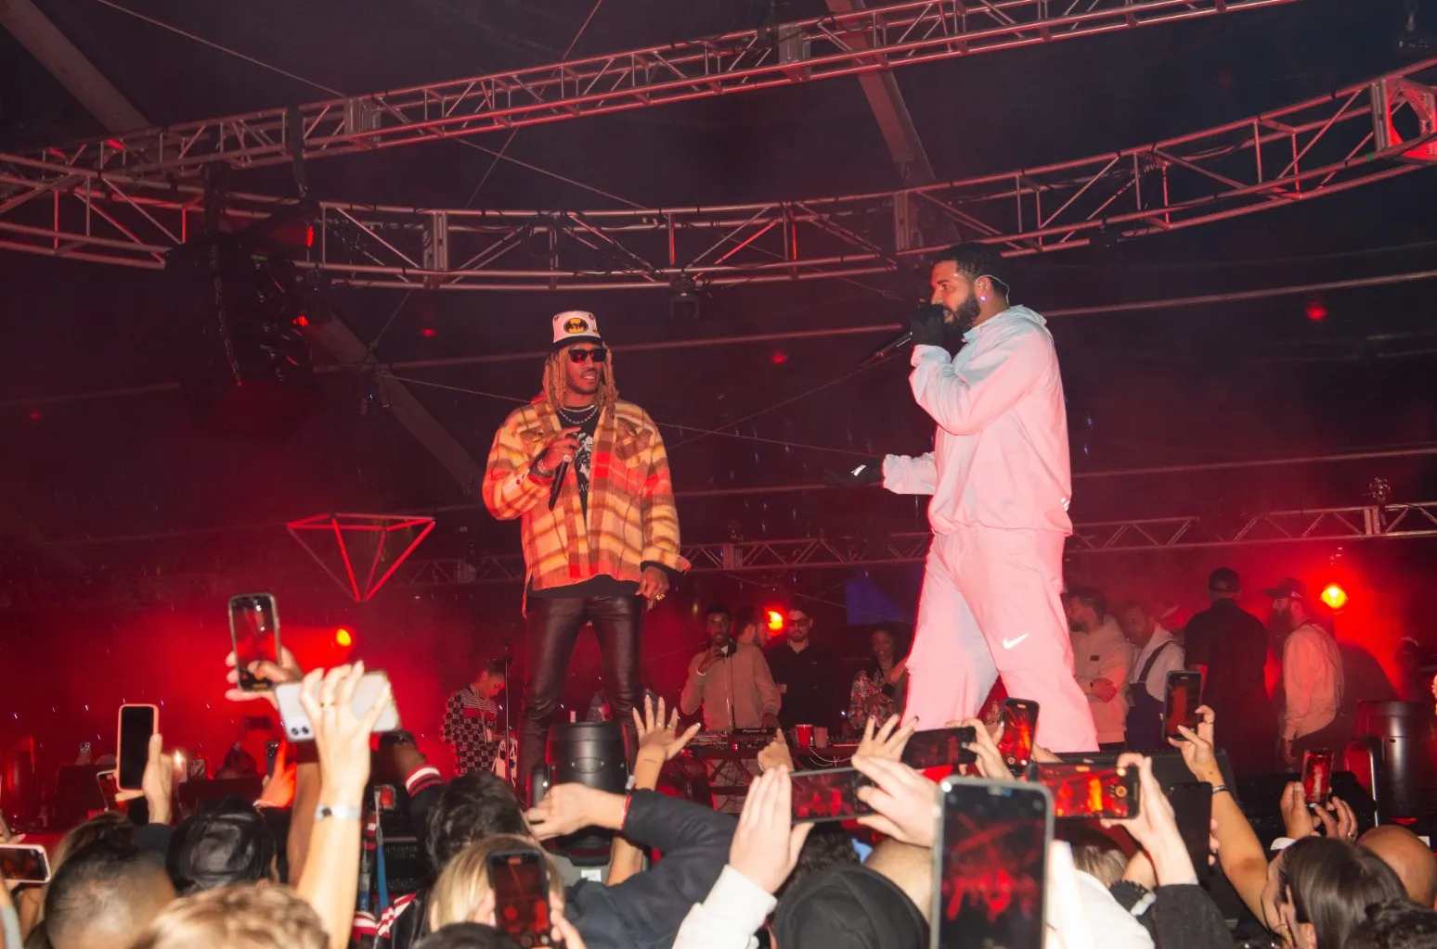
YOLO

Slide 10
YOLO

Slide 12
Yolo Detect

Slide 13
Yolo Segmentation

Slide 14
Yolo Classification

Slide 15
Yolo datasets

Slide 16
Pyttsx3
This Photo by Unknown Author is licensed under CC BY-NC

Slide 17
Future of the Project
This Photo by Unknown Author is licensed under CC BY-NC

Slide 18
Live Demonstration!

