Slide 1
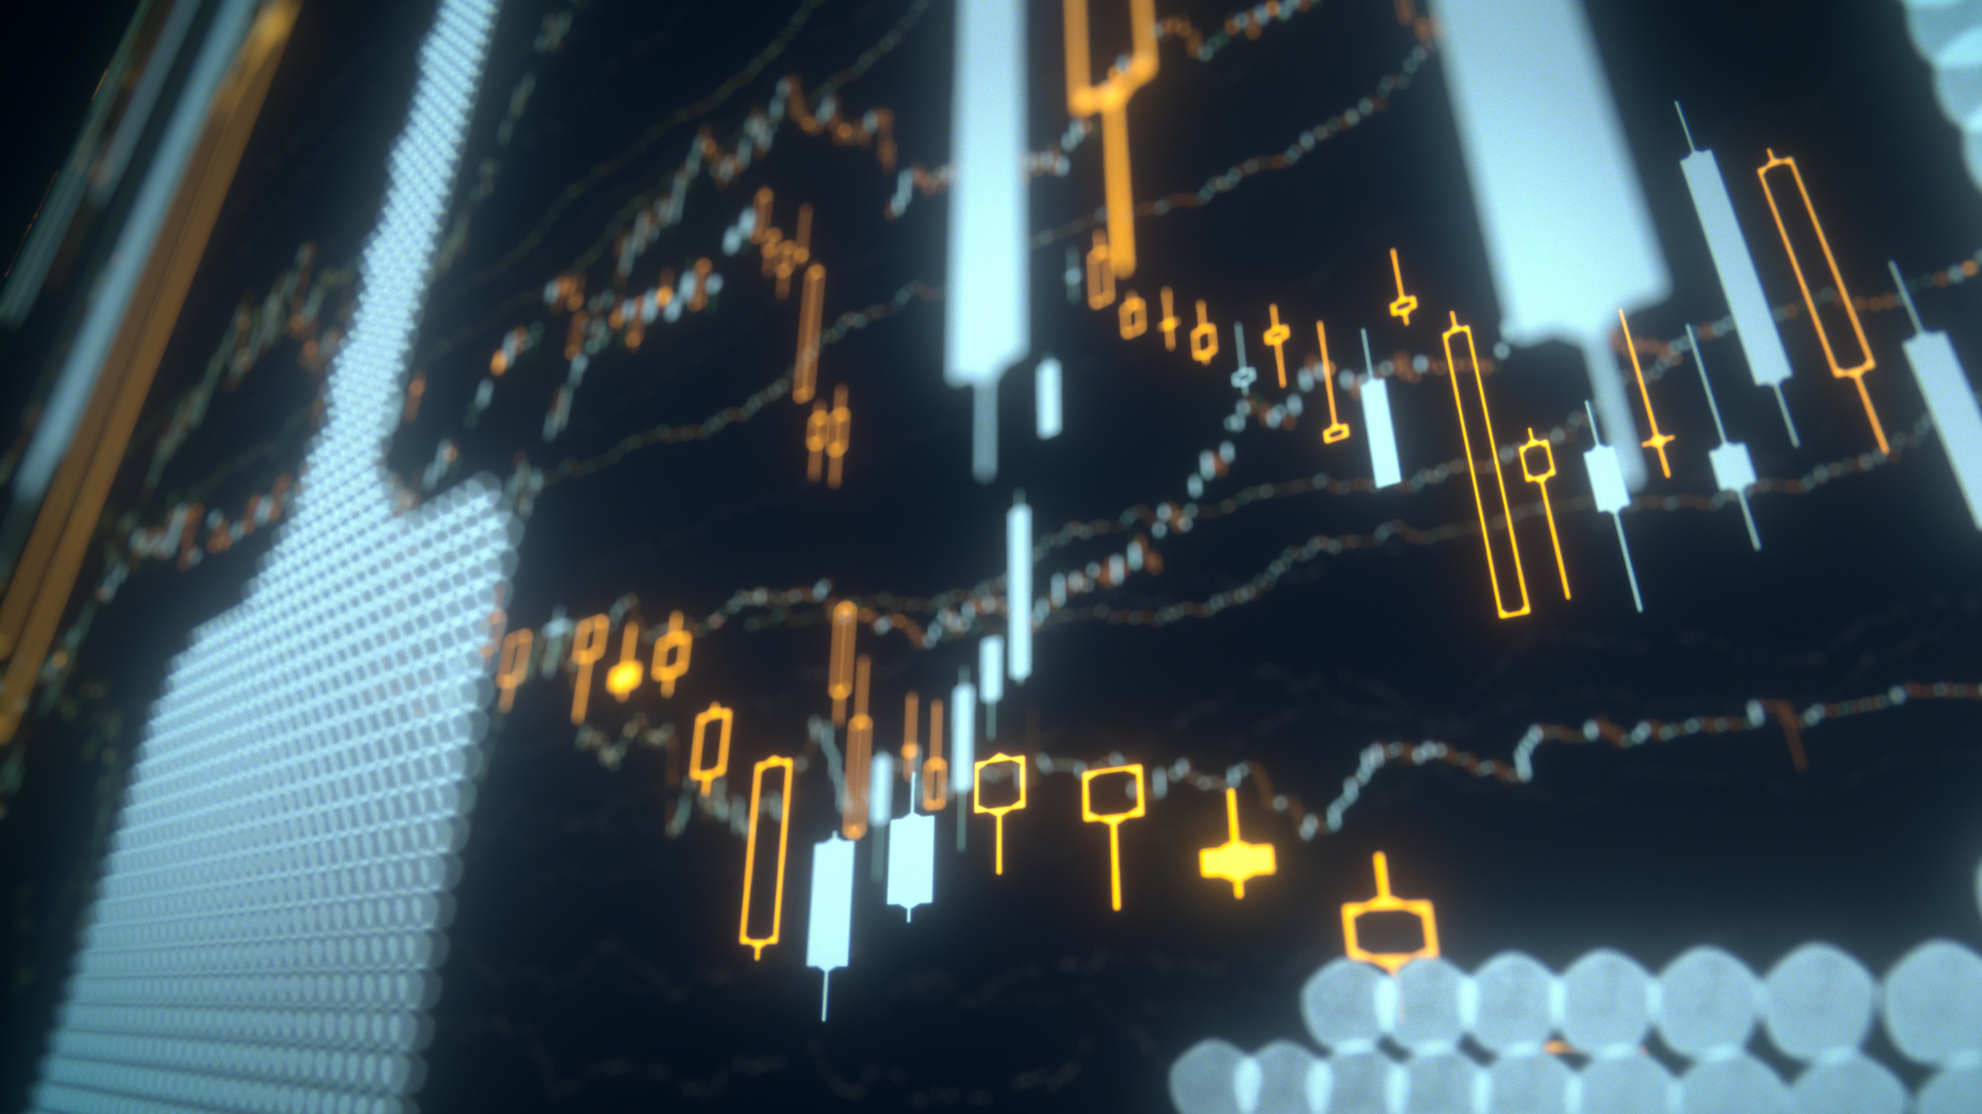
Introduction
Stock Market Pattern Recognition
I have developed a web application using React.js and Firebase for authentication to help identify patterns in the stock market. This project aims to provide investors with a powerful tool for analyzing and making informed trading decisions.
What is a stock?
It is a marketplace where individuals buy and sell publicly traded companies.
Seth Leung Woo-Gabriel

Slide 2
Project Overview
✓
Identify Stock Market Patterns
✓
Provide an Intuitive Interface
Develop an application that can recognize and analyze recurring patterns in stock market data to aid investment decisions.
Create a user-friendly web application that makes it easy for investors to visualize and interact with stock market data.
✓
Enhance Investment Strategies
✓
Leverage Emerging Technologies
Empower investors with insights and tools to improve their stock market investment strategies and decision-making.
Utilize the latest advancements in web development, data analysis, and machine learning to build a cutting-edge stock pattern recognition system.
Purpose: The purpose of this project is to highlight the stock market pattern recognition in a web application that will help the user make informed investment decisions.

Slide 3
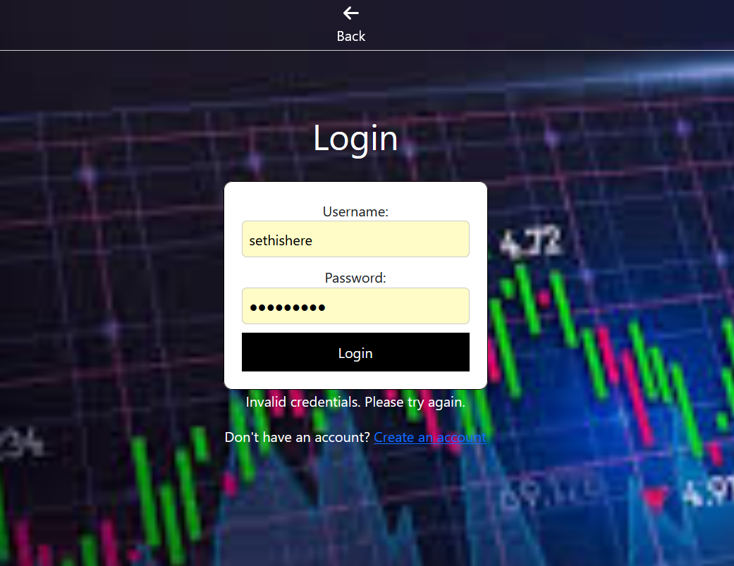
Technology Stack
Client-Server Architecture
The front-end React.js application communicates with a backend server, leveraging Firebase's cloud services for data storage and user authentication.
Secure Authentication
The integration of Firebase Authentication provides a robust and secure user login and registration system, protecting user data and account information.

Slide 4
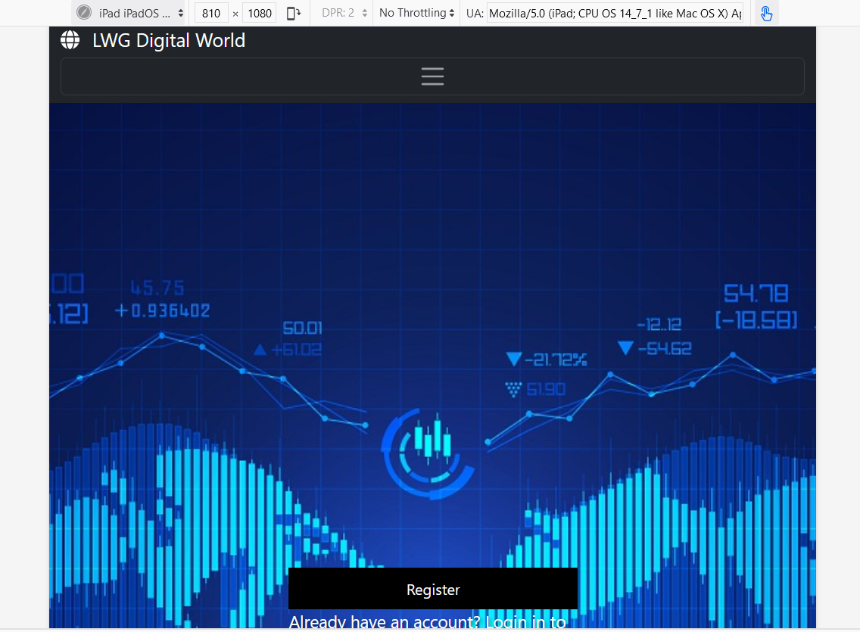
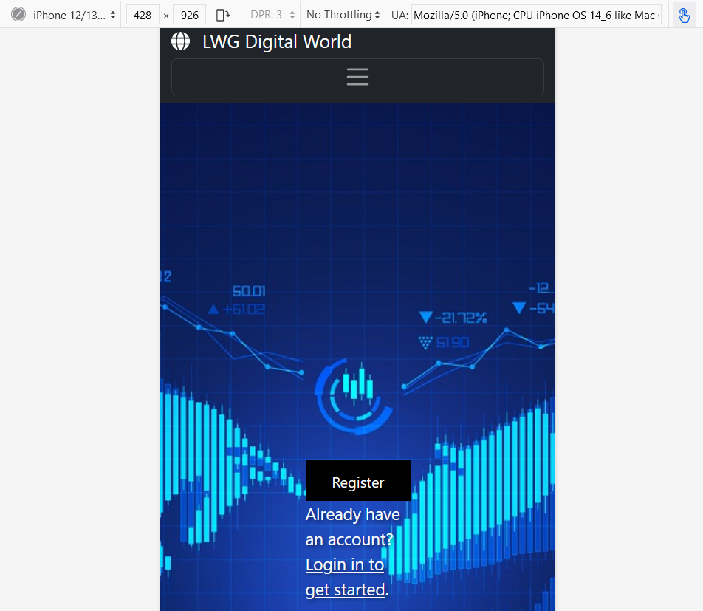
Technology Stack
Modular Design
The application is built using a modular, component-based approach with React.js, allowing for easy scalability and maintainability.
Responsive User Interface (UI)
The web app features a responsive and mobile-friendly user interface, ensuring a seamless experience across various devices and screen sizes.

Slide 5
Key Features and Functionalities of the App
Intuitive Dashboard: A sleek and user-friendly dashboard that provides real-time stock market data and analysis tools.
Automated Pattern Recognition: Advanced algorithms that scan the market and identify promising stock patterns to help users make informed decisions.
💡 Personalized Alerts: Customizable alerts that notify users of significant market movements or the emergence of their tracked patterns.

Slide 6
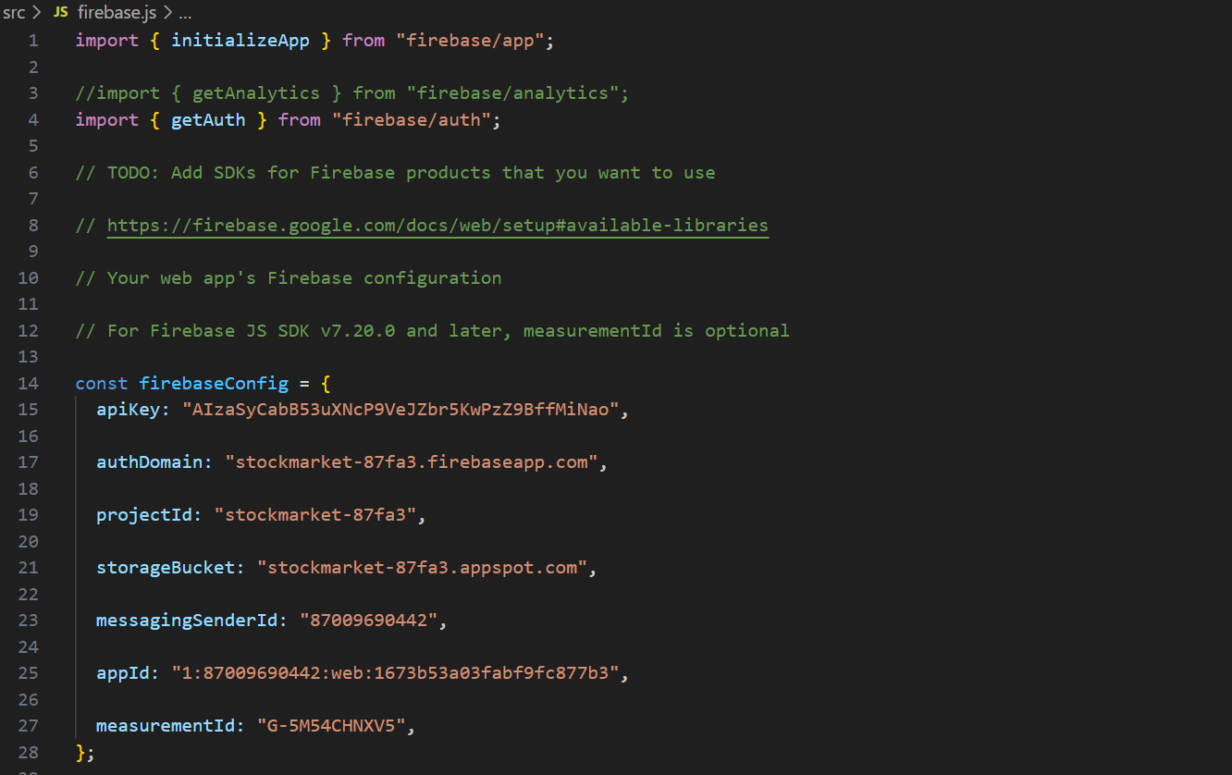
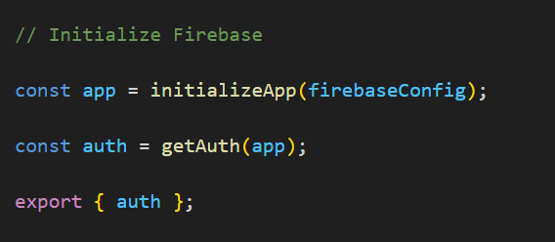
Implementation Details
Integration firebase for user authentication

Slide 7
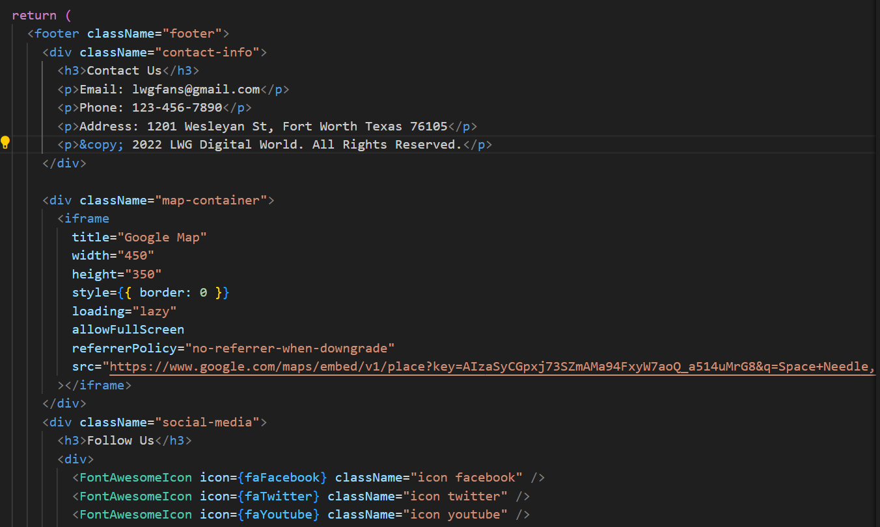
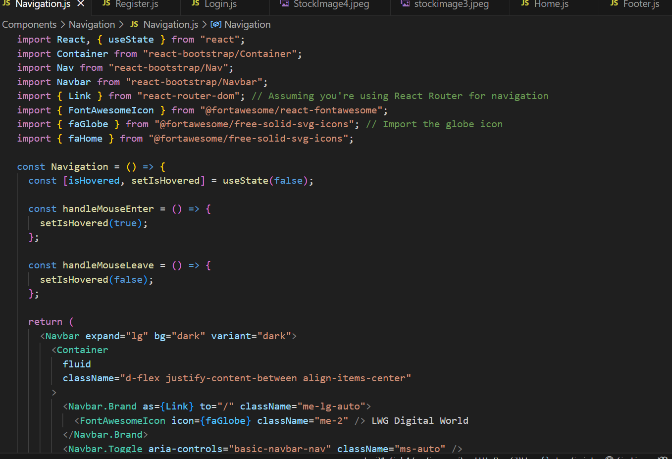
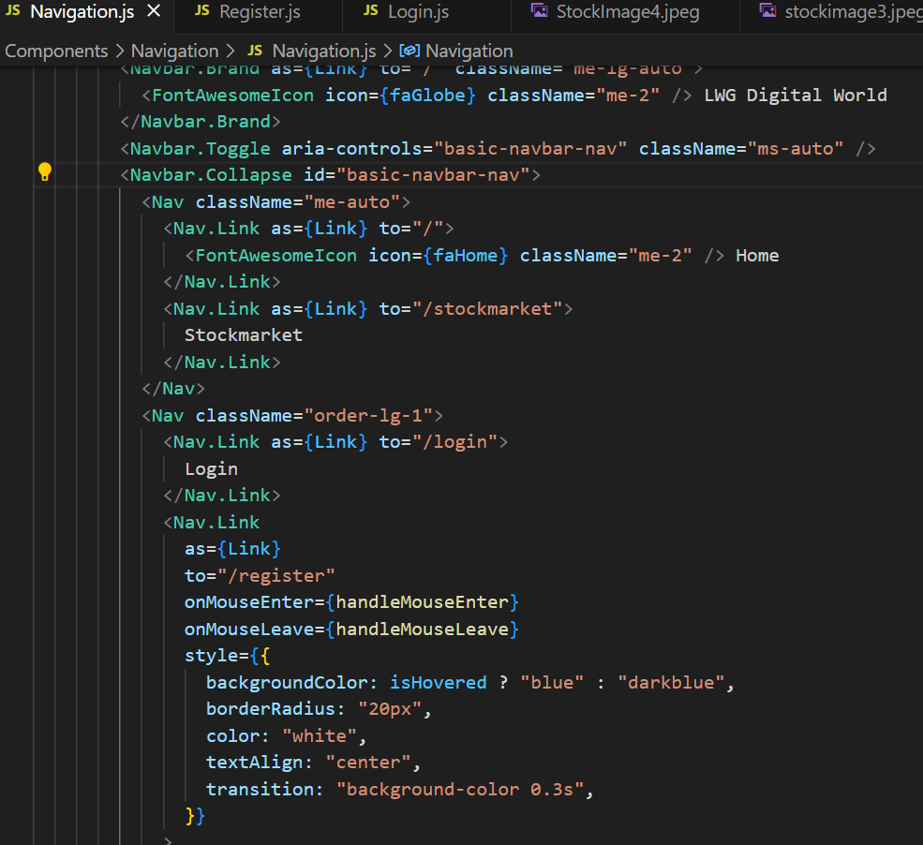
Front-End & Back-End Components (Implementation Details cont'd)

Slide 8
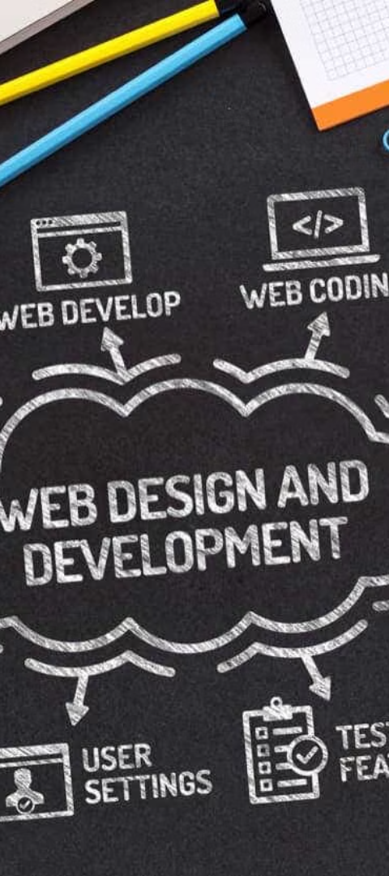
Challenges Experienced
1
Learning Curve
Familiarizing myself with React.js and Firebase took time and effort, as they were new technologies for me. I had to invest in training and tutorials to get up to speed.
2
Integrating APIs
Integrating the stock market data APIs with my React.js application was a complex task, requiring careful coordination between the front-end and back-end components.
3
Optimization Challenges
Ensuring optimal performance and responsiveness of the web application was an ongoing challenge, especially when handling large amounts of real-time stock data.

Slide 9
Future Enhancements and Improvements
Expand Data Sources
Advanced Analytics
Personalized Dashboards
Mobile Accessibility
Integrate additional data sources, such as real-time market news and social media sentiment, to further enhance the pattern recognition capabilities.
Implement more sophisticated machine learning algorithms to identify complex market trends and provide more accurate predictions.
Allow users to customize their dashboards, setting preferences for the types of patterns they want to monitor and the way data is presented.
Develop a mobile-friendly version of the application, enabling users to access the pattern recognition tools on-the-go.

Slide 10
Impact and Benefits of the Project
Increased Market Insights
Time-Saving Automation
Potential for Growth
The web application provides users with advanced pattern recognition capabilities, enabling them to gain deeper insights into stock market trends and make more informed investment decisions.
By automating the pattern analysis process, the app helps users save valuable time, allowing them to focus on strategic decision-making rather than manual data crunching.
The project lays the foundation for further enhancements and expansion, positioning the web application as a powerful tool for long-term success in the stock market trading arena.

Slide 11
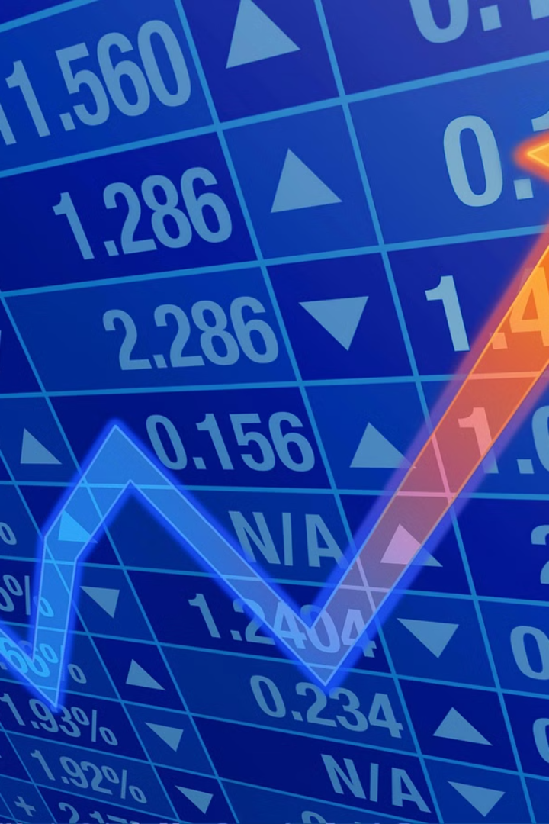
Conclusion and Key Takeaways
In conclusion, the web application developed for the stock market pattern recognition project has delivered significant benefits. The integration of React.js and Firebase has enabled a robust and user-friendly platform for analyzing market trends and making informed investment decisions.
The key takeaways from this project include the power of leveraging modern web technologies, the importance of secure user authentication, and the potential for data-driven insights to drive financial success. As we move forward, continued enhancements and expansion of the application's capabilities will further amplify its impact on the investing community.

